Slide 1

The K-Frequent Pattern
By Ariel Avshalom

Slide 2
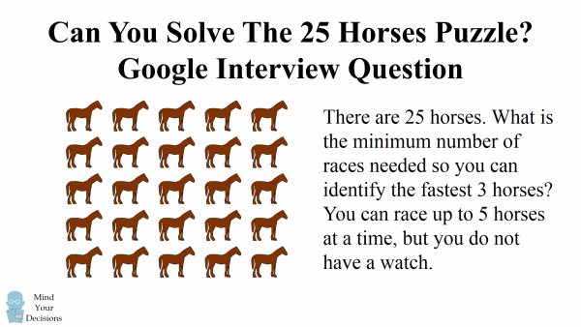
Thought question: Google’s 25 horses' problem
Once upon a time, brain teasers were a part of the process in a tech interview
One of those teasers is the 25 horses problem
Notes:
Start with a thinking problem to show that there are many problems in this class.

Slide 3
How would you approach this problem?
Work with the details you have
You can race 5 horses at a time
You do not have a watch
Do you all remember an algorithm which does something similarly to this (at least conceptually)?
Quicksort!

Slide 4
This is another way of creating partitions in your input
You can split the horses into groups of 5
Race those horses
Then race the resulting set of the 5 fastest horses in each group
This will at least give you the fastest horse, but how do you take it further?
You know more information about the horses and with just one more race, you can determine which 3 horses are the fastest!
Notes:
So you need 6 races or so to complete this. How does this change with larger or different inputs? Can there be a smarter way to do this than with random race magic?

Slide 5
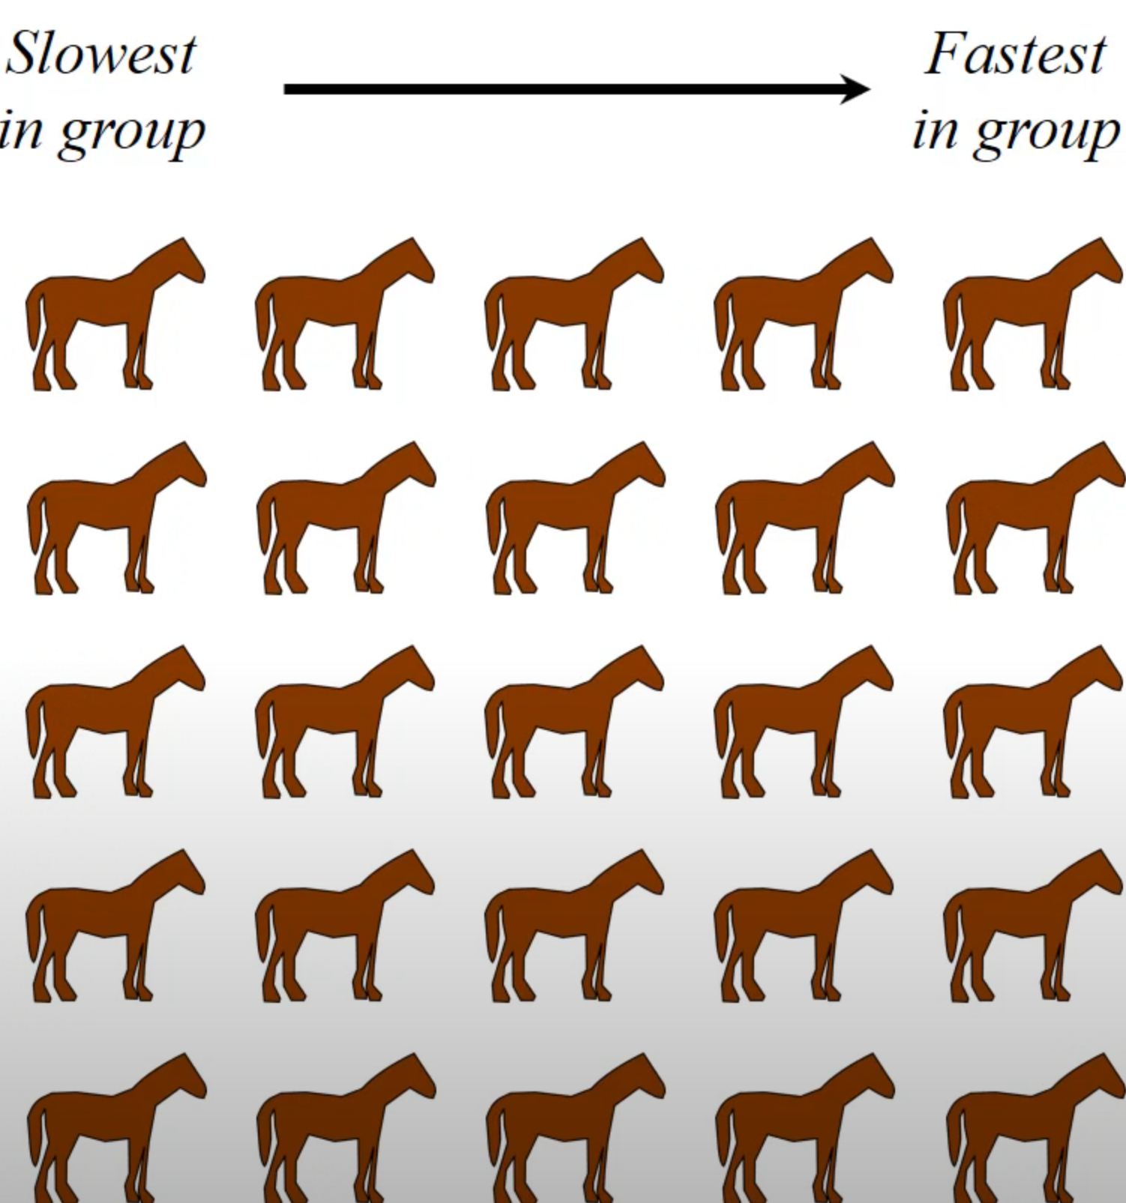
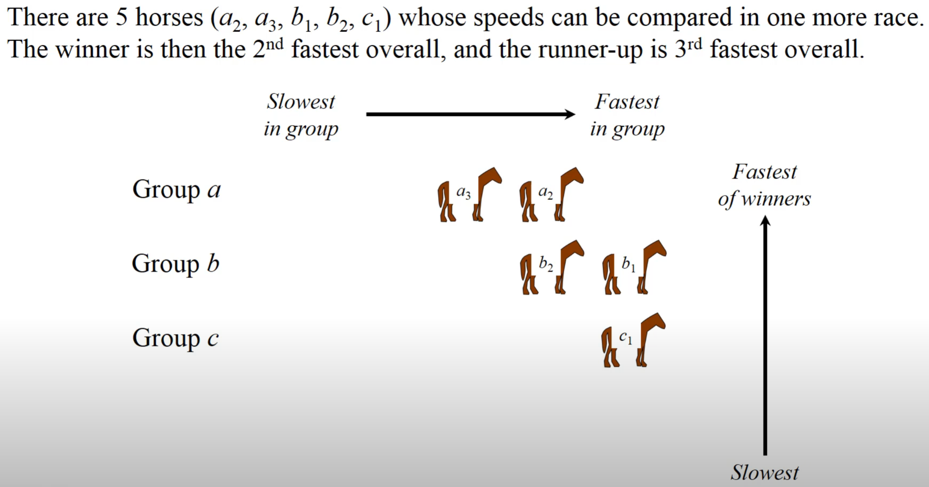
Result

Slide 6
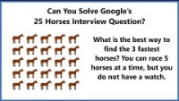
Video source

Slide 7
What is the value of this thought experiment?
It allows us to segue directly into today’s pattern: “Top K Elements”
In this pattern, you are given an unordered array and told to extract
The kth largest value
K values around the median
The k most frequent words
The most traded stock of the day
Notes:
Note rework this slide so that each example comes out separately in the animations

Slide 8
Ways to solve the problem
Sort the array (O(nlogn)) or O(n^2) time)
Use bucket sort partitions or quicksort partitions (O(n) time if the right conditions are met or if you use the partition approach correctly)
Employing a heap (while it takes O(nlogn) time to implement, it is good for repeated requests like looking up the top 20 stocks traded in a day)

Slide 9

Problem space: finding the k-largest values
Assume our problem is the following:
Find the 5 largest values in an array of n values
Here are how you would implement it with the 3 approaches listed above:

Slide 10
Using a sorting algorithm
You’d likely be expected to code your own sorting algorithm if you take this approach
Sort the array
Select the top 5 values
Is there a better way to do this without sorting the array?

Slide 11
Recursively call max
Create a max function and pop out values from the original array 5 times
Note that while this is O(n) for small values of k, this can be bad if k approaches n.

Slide 12

What about bucket sort or partitions?
Bucket sort works well if you:
Maintain similar densities across buckets (like with a random distribution)
Approach k = n buckets as you recursively split your input
Anyone reminded of the pigeonhole principle and cyclic sort?
Notes:
Spend time now discussing and showing both of these algorithms on a whiteboard

Slide 13

Using a heap
Generally, there are two kinds of arrays you cover in university:
max heaps
min heaps
How do we implement them and what methods do they have?
Notes:
Show code for this in JS or Python or Java. There’s lots of that freely available online!

